Slide 1
CPS-101 ICT Fundamentals
Lecture – 8
Lecturer Rabia Khan

Slide 2
Basic Security Concepts
Threats
  Anything that can harm a computer
  Vulnerabilities are weaknesses in security
  Security attempts to neutralize threats

Slide 3
Basic Security Concepts
Degrees of harm
  Level of potential damage
  Include all parts of system
    Potential data loss
    Loss of privacy
    Inability to use hardware
    Inability to use software

Slide 4
Basic Security Concepts
Countermeasures
  Steps taken to block a threat
  Protect the data from theft
  Protect the system from theft

Slide 5
Threats To Users
Identity Theft
  Impersonation by private information
    Thief can ‘become’ the victim
  Methods of stealing information
    Shoulder surfing: watching someone enter some confidential info
    Snagging : overhearing conversation not meant for you, listening to a telephonic conversation
    Dumpster diving: going through dumps
    Social engineering: to trick the victim to provide information
    High-tech methods: use of technology to steal

Slide 6
Threats To Users
Loss of privacy
  Personal information is stored electronically
  Purchases are stored in a database
    Data is sold to other companies
  Internet use is monitored and logged
  Data about when you visited, what you looked at and how long you stayed at a particular website is used by them and use of this data is called “online profiling”. They build a profile of your interests.

Slide 7
Threats to Users
Cookies
  Webserver asks your browser to place a textfile on your computer containing info about your computer, email address, last time you visited the site, info about downloaded pages etc.
  Files delivered from a web site
  Originally improved a site’s function
  Cookies now track history and passwords
  Browsers include cookie blocking tools

Slide 8
Threats to Users
Spyware
  Software downloaded to a computer
  Designed to record personal information
  Typically undesired software
  Hides from users
    Typically, spyware is secretly installed on the user's personal computer. Sometimes, however, spywares such as keyloggers are installed by the owner of a shared, corporate, or public computer on purpose in order to secretly monitor other users.
  Several programs exist to eliminate called AntiSpyware for e.g. AVG Anti-Spyware
Notes:
Keystroke logging (often called keylogging) is the practice of tracking (or logging) the keys struck on a keyboard, typically in a covert manner so that the person using the keyboard is unaware that their actions are being monitored.
Keylogger is a device or program that captures activities from an input device. Malicious people can make use of keyloggers to capture personal information being input into a computer system.

Slide 9
Threats to Users
Web bugs
  A Web Bug is a graphics on a Web page or in an Email message that is designed to monitor who is reading the Web page or Email message. Web Bugs are often invisible because they are typically only 1-by-1 pixel in size.
  Small programs embedded in gif images
  Companies use to track usage
  Blocked with spyware killers
  Alternative names are web beacon, tracking bug, and tag or page tag

Slide 10
Threats to Users – Web Bugs
Alarming …!!
  Sites : Quicken , FedEx , Metamucil , Oil of Olay StatMarket etc were found to have web bugs
How can I see a Web Bug on a page?
  A Web Bug can be found by viewing the HTML source code of a Web page and searching for IMG tags. A Web Bug will typically have its HEIGHT and WIDTH parameters in the IMG tag set to 1. Also for the tag to be a bug, the image should be loaded from a different server then the rest of the Web page.
Notes:
When a Web Bug is viewed, it sends following information :
The IP address of the computer that fetched the Web Bug
The URL of the page that the Web Bug is located on
The URL of the Web Bug image
The time the Web Bug was viewed
The type of browser that fetched the Web Bug image
A previously set cookie value

Slide 11
Threats to Users
Spam
  Spam is flooding the Internet with many copies of the same message, in an attempt to force the message on people who would not otherwise choose to receive it. Most spam is commercial advertising, often for dubious products, get-rich-quick schemes etc.
  Unsolicited (Unwanted) commercial email
  Networks and PCs need a spam blocker
    Stop spam before reaching the inbox
  Examples of SpamBlockers : eTrust Anti-Spam, ChoiceMail Free etc

Slide 12
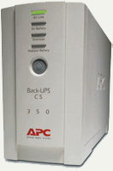
Threats to Hardware
Affect the operation or reliability
Power-related threats
  Power fluctuations
    Power spikes or browns out
  Power loss
  Countermeasures
    Surge suppressors
    Line conditioners
    Uninterruptible power supplies
    Generators
Notes:
Larger installations use generators to protect networks. Hospitals, grocery stores and insurance companies may all use generators. Quite often the power solution is a combination of battery and generator. The batteries run long enough for the generators to start and stabilize. Then the batteries stop and the generators provide power to the facility.

Slide 13
Threats to Data
The most serious threat
  Data is the reason for computers
  Data is very difficult to replace
  Protection is difficult
    Data is intangible

Slide 14
Threats to Data
Viruses
  Software that distributes and installs itself
  Ranges from annoying to catastrophic
  Countermeasures
    Anti-virus software
    Popup blockers
    Do not open unknown email

Slide 15
Threats to Data
Trojan horses
  It is a harmful piece of software that looks legitimate. Users are typically tricked into loading and executing it on their systems. Program that poses as beneficial software
  User willingly installs the software
  Countermeasures
    Anti-virus software
    Spyware blocker

Slide 16
Threats to Data
Internet fraud
  Most common cybercrime
  Fraudulent website
  Have names similar to legitimate sites
Distributed denial of service attack
  Attempt to stop a public server
  Hackers plant the code on computers
  Code is simultaneously launched
  Too many requests stops the server

Slide 17
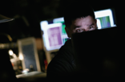
Threats to Data
Hacking
  Using a computer to enter another network
  Cost users $1.3 trillion in 2003
  Hackers motivation
    Recreational hacking
    Financial hackers
    Grudge hacking
  Hacking methods
    Sniffing
    Social engineering
    Spoofing

Slide 18
Threats to Data
Cyber terrorism
  Attacks made at a nations information
  Targets include power plants
  Threat first realized in 1996
  Organizations combat cyber terrorism
    Computer Emergency Response Team (CERT)
    Department of Homeland Security
Notes:
Teaching tip
CERT’s home page is located at www.cert.org.

Slide 19
Taking Protective Measures

Slide 20
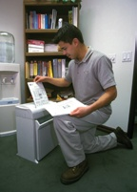
Protective Measure : Avoiding Identity Theft
Guard your papers
  Shred unneeded papers
  Pick up you mail quickly
  Check statements immediately
  Keep records for 3 years
Guard your personal information
  Be wary giving out information
  Avoid giving account numbers
  Never give personal information in e-mail
  Ensure online shopping is secure
Notes:
.

Slide 21
Managing Cookies and Spyware
Dealing with cookies
  Browsers provide settings to block cookies
  Without cookies some sites crash
  Cookies can be deleted
    Browsers
    Spyware programs

Slide 22
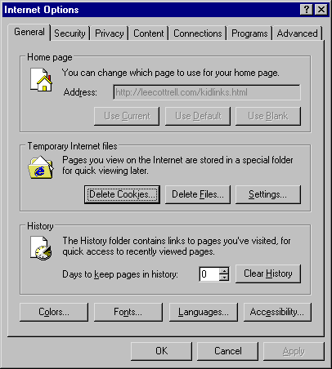
Deleting Cookies

Slide 23
Managing Cookies and Spyware
Removing web bugs and spyware
  Install a spyware removal program
    None are 100% effective, use two
  Install a pop-up blocker
    Are extremely effective

Slide 24
Managing Cookies and Spyware
Evading spam
  Contact your ISP
  Use mail program’s filters
  Use an anti-spam program
  Use an online account for purchasing

Slide 25
Protection From Malware
Viruses and worms
  Purchase a good anti-virus product
  Keep the product updated
  Keep your OS up to date

Slide 26
Protecting Your System
Limit physical access
  Easiest way to harm or steal data
  Build an account for each user
  Require a password for access
    Software and hardware password

Slide 27
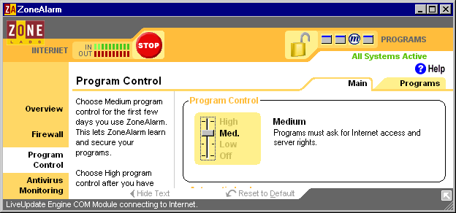
Protecting Your System
Use a firewall
  Protects from unauthorized remote use
  Makes your computer invisible
  Available free of cost too!

Slide 28
Protecting Your System
Backup often
  Backup is a copy of a file
  Restore replaces a file on disk
  Organizations backup at least daily
  Home users should backup weekly

Slide 29
Suggested Reading
Chapter 13, “Protecting Your Privacy, Your Computer and Your Data”, Introduction to Computers by Peter Norton, 6th Edition.

